Slide 1
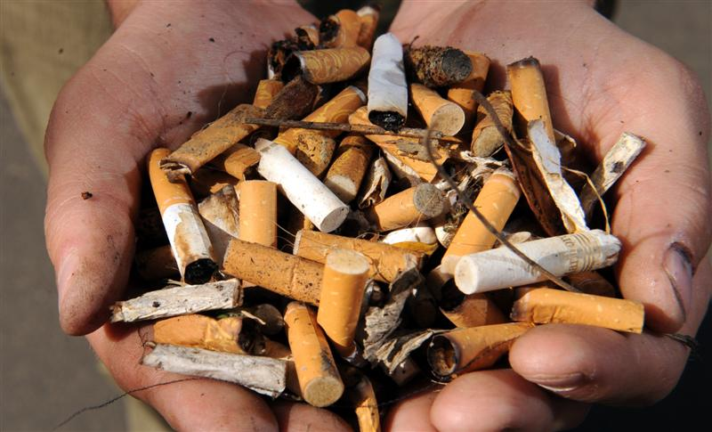
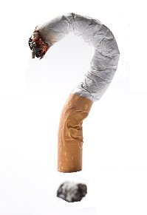
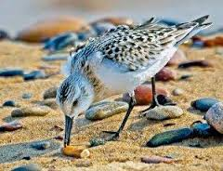
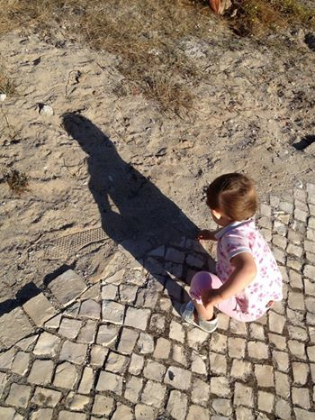
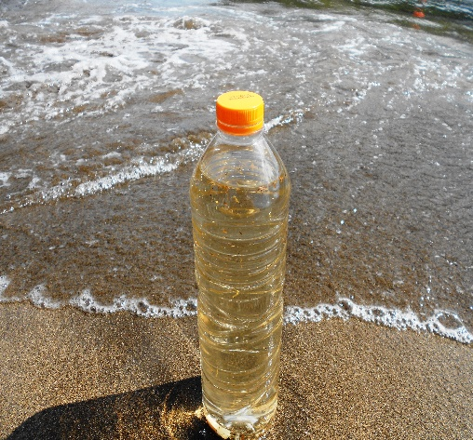

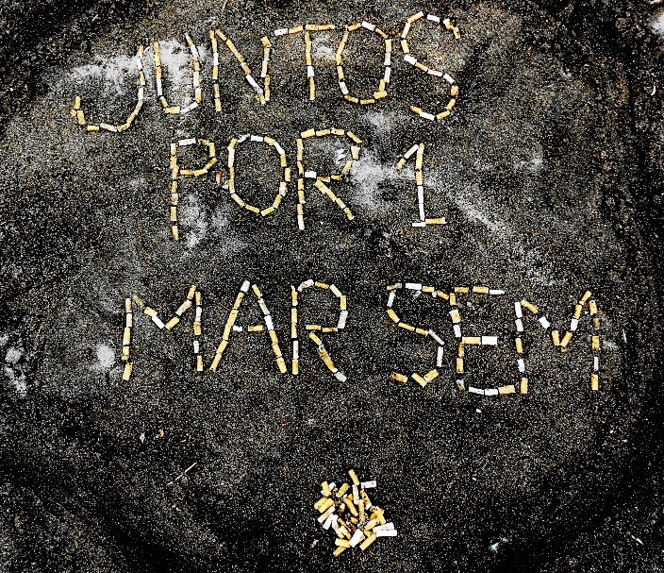



Did you know
Cigarette butts are the most frequent waste on beaches worldwide.
Today cigarette butts are not biodegradable!
Birds and fish mistake cigarette butts with food and die.
Children do not understand why they should not play or put cigarette butts in the mouth
1 cigarette butt can contaminate up to 2L of water with about 4700 toxic substances
7000 cigarette butts per minute are thrown to the ground in Portugal.
These are washed away by rainwater and go to the Sea
For a better environment,
Let's spread this message!

