Slide 1
Marine litter, cigarette butts and bottle bills
Be part of the solution!
daniel.gomes@tararecuperavel.org

Slide 2
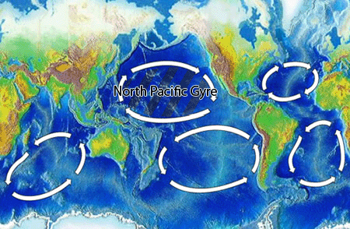
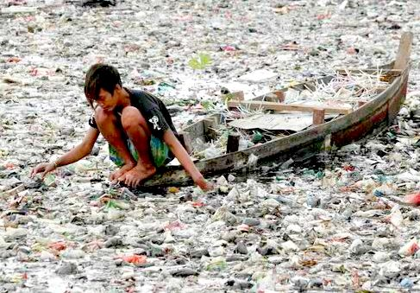
Where is the Marine Litter?
Far away on the “Plastic Islands” of the Pacific?

Slide 3

Marine Litter is at our door in Portugal
First plastic tide reaches Baleal in 2014 (Peniche, Portugal)
https://youtu.be/bJ0plbA4jS0?list=PL7-uDWndCrxaqaRr9tDS4_zwnKRjA_0ux

Slide 4
In the winter, most of the beautiful Portuguese beaches look like this
This scenery is usual at our wild beaches (Ferrel, Peniche, Portugal)
https://youtu.be/-iQKs4Q7r0o

Slide 5
How does Marine Litter affects us?
Ecosystem
  Traps and kills birds
  Contaminates fish
  Habitat destruction (ex. dune vegetation)
Society and Economy
  Fishing: ship damaging, less fish
  Tourism: who loves to promenade along the garbage?
  Taxes: beach cleaning paid by municipalities
  Public health: accidents with trash (broken glass, needles)

Slide 6
What is Marine Litter
?

Slide 7
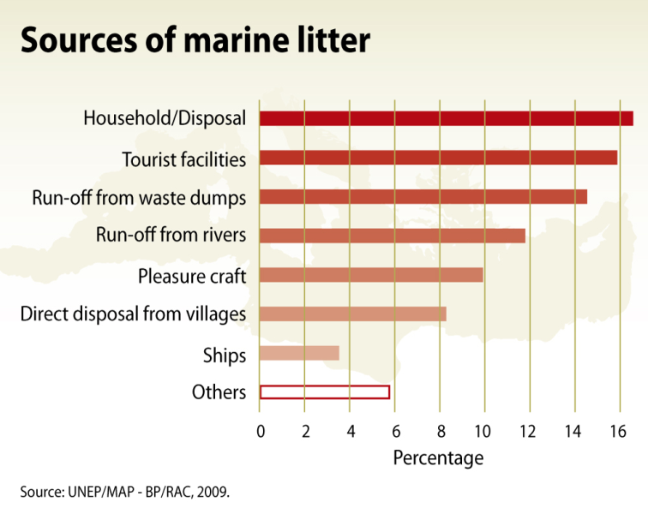
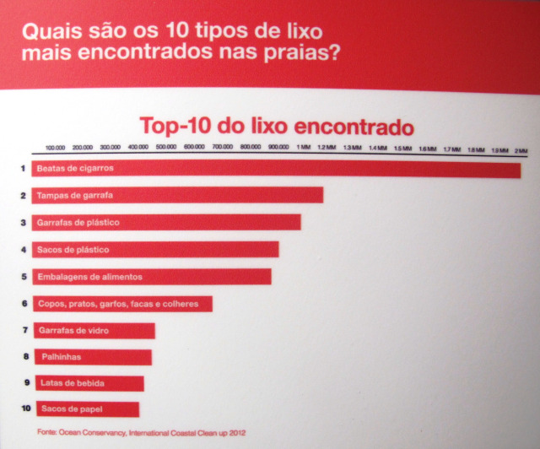
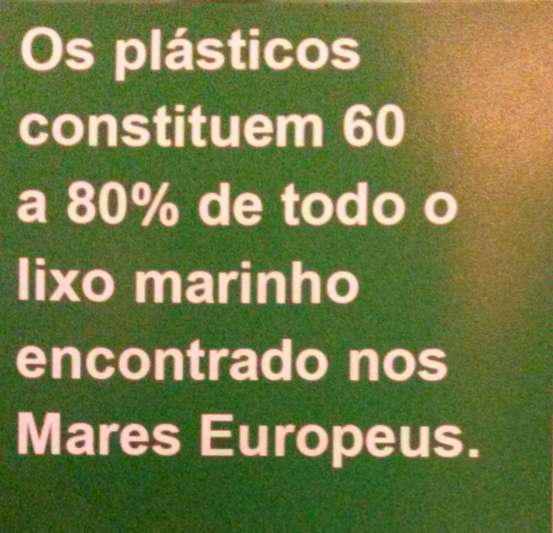
Origins of Marine Litter

Slide 8
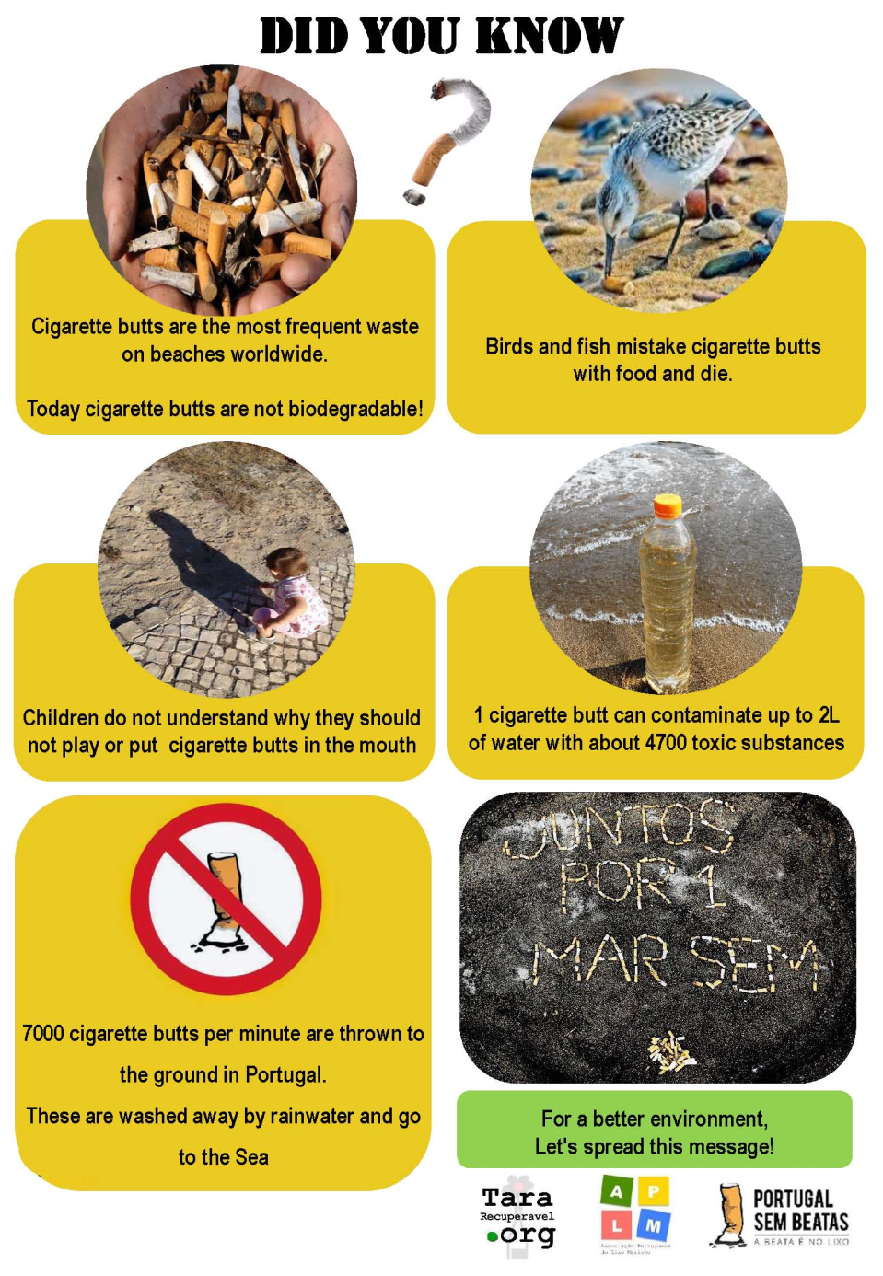
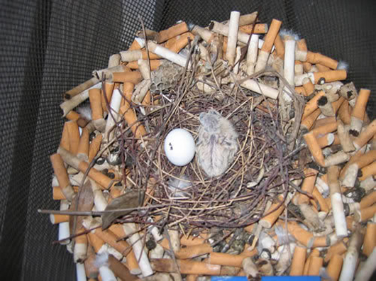
Cigarette butts: an underestimated environmental issue

Slide 9
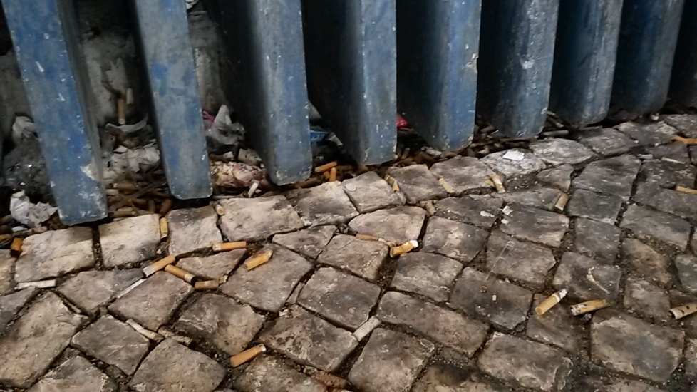
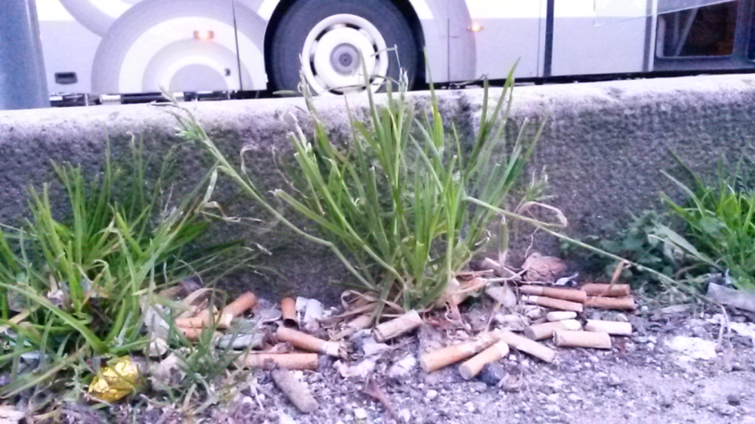
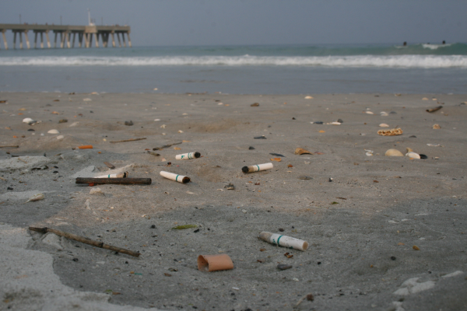
A huge sociological and psychological problem in Portugal

Slide 10
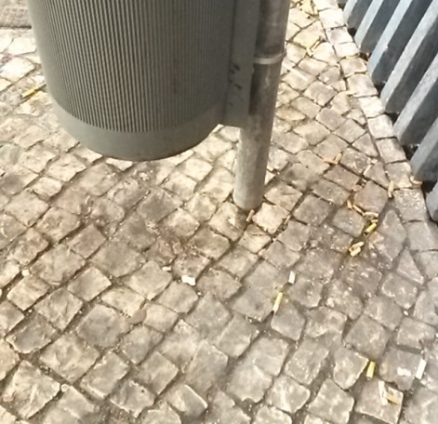
Easy to solve: wanna bet?
Reduce at least by 50% the amount of cigarette butts on the surroundings of this container.
Spending at most 0.05 €

Slide 11
Add a stickers with a visible awareness message
Did you know that cigarette butts
are also garbage?
It works!

Slide 12

A business opportunity?
Pre-built garbage containers with awareness messages
Low production and investment costs
  Existing containers with cheap stickers
Easy to demonstrate effectiveness
  Annoying problem that frustrates people
  Try and buy
Immediate perception of return of investment by clients
  Reduces visible garbage
  Reduces cleaning costs

Slide 13

To finish bottle littering everywhere
My voluntary project to fight
Marine Litter (and other problems)
Daniel Gomes
daniel.gomes@tararecuperavel.org

Slide 14
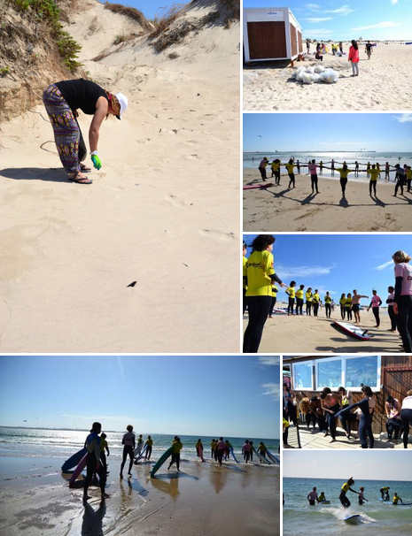
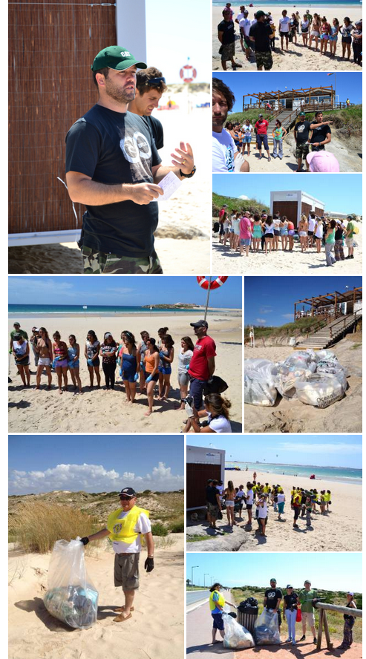
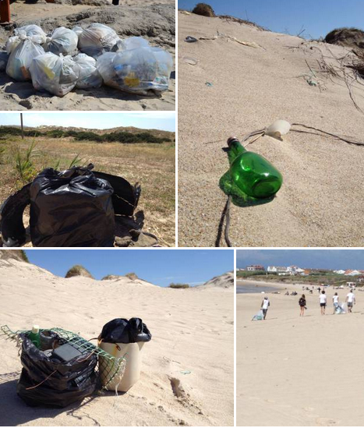
I participate on beach clean-ups

Slide 15
Beverage containers are the origin of 4 prevalent types of Marine Litter

Slide 16

And this is not just “theory”
https://www.facebook.com/TaraRecuperavel/videos/vb.237580539681953/833995373373797/?type=2&theater

Slide 17
But used bottles are not just Marine Litter.
They litter every place in Portugal

Slide 18
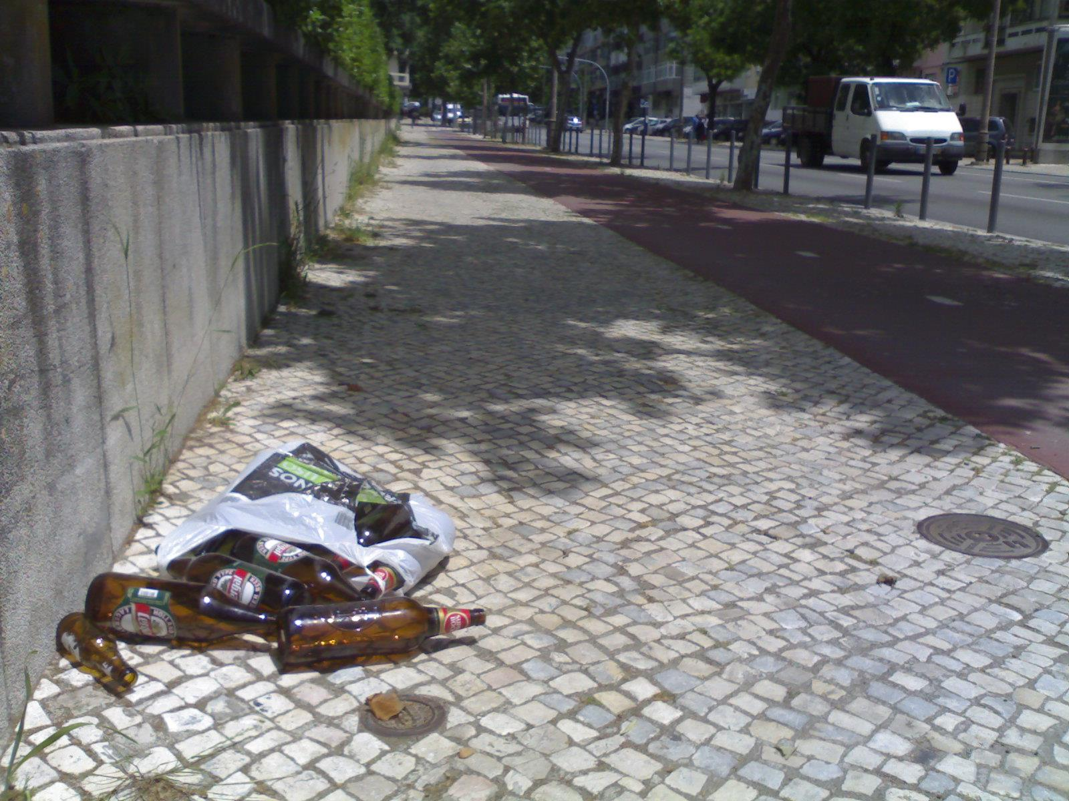
Sidewalks

Slide 19
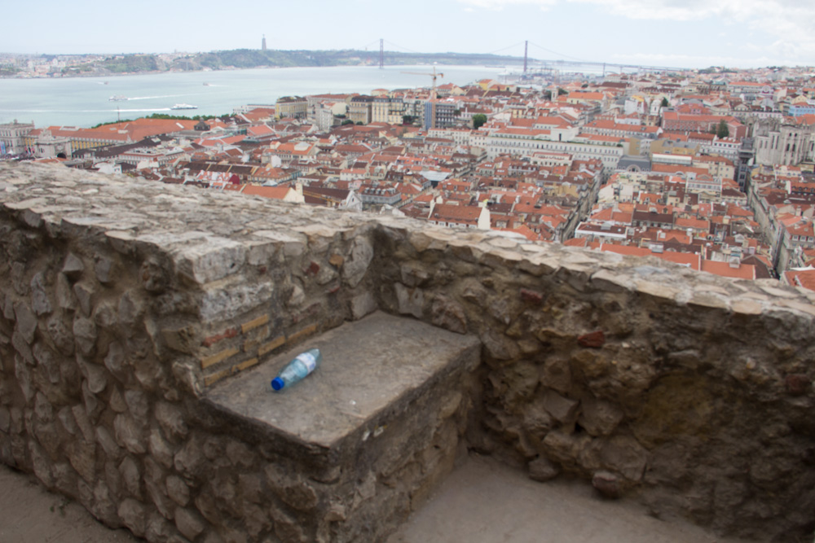
Monuments

Slide 20
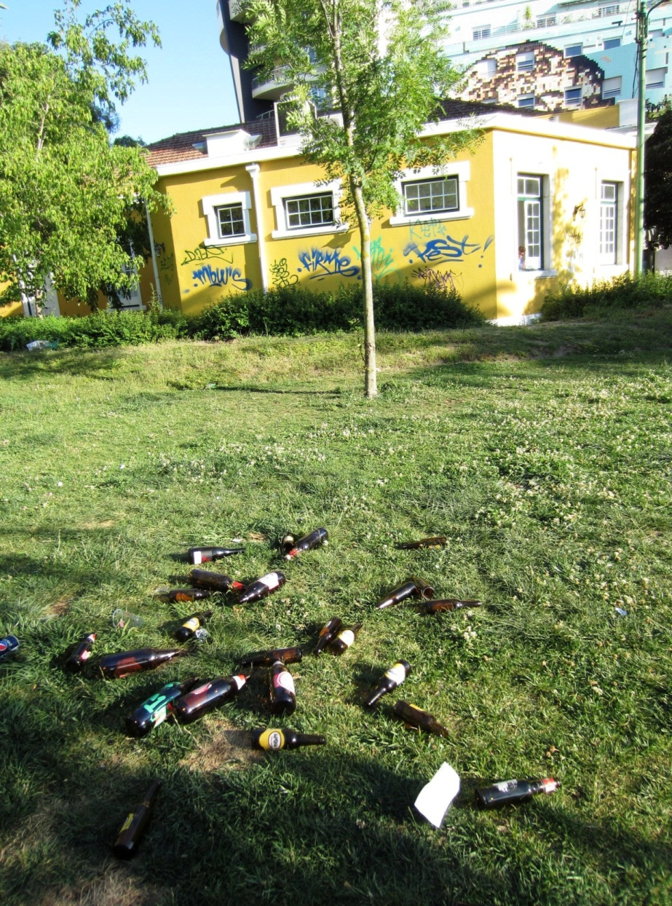
Gardens

Slide 21
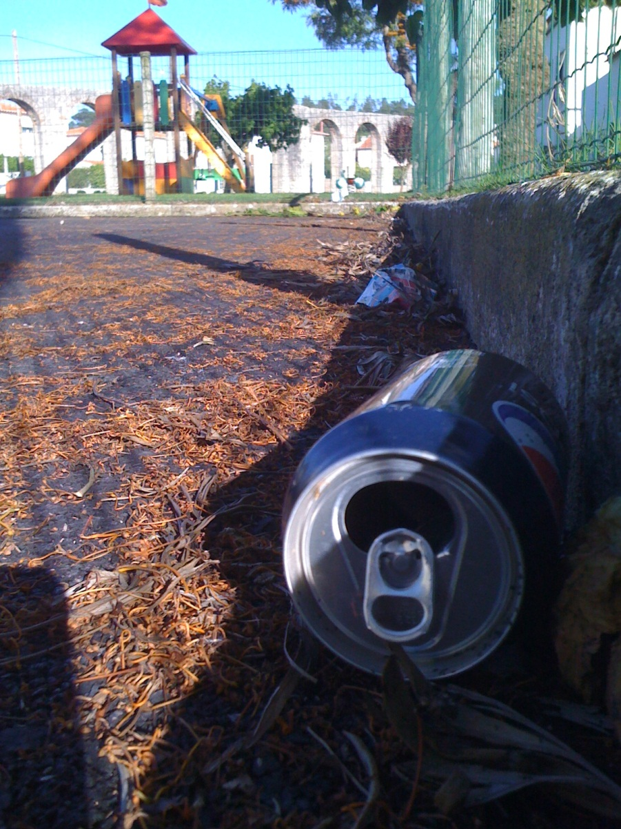
Children playgrounds

Slide 22
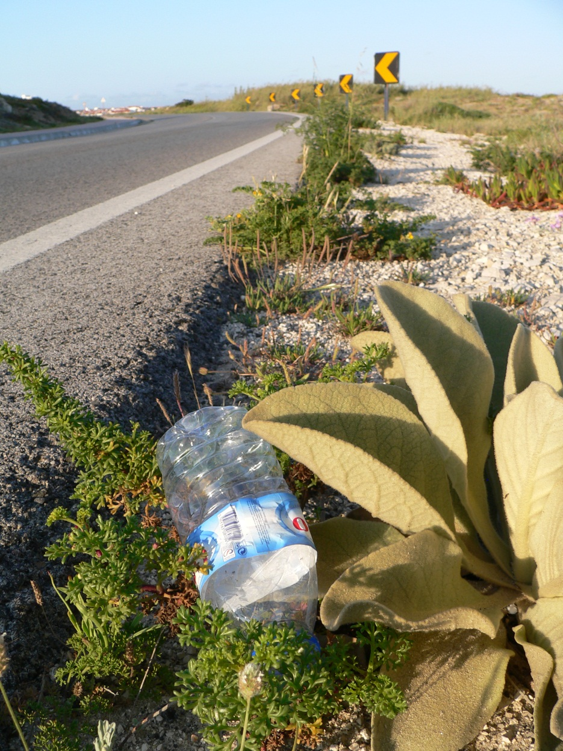
Roadways

Slide 23
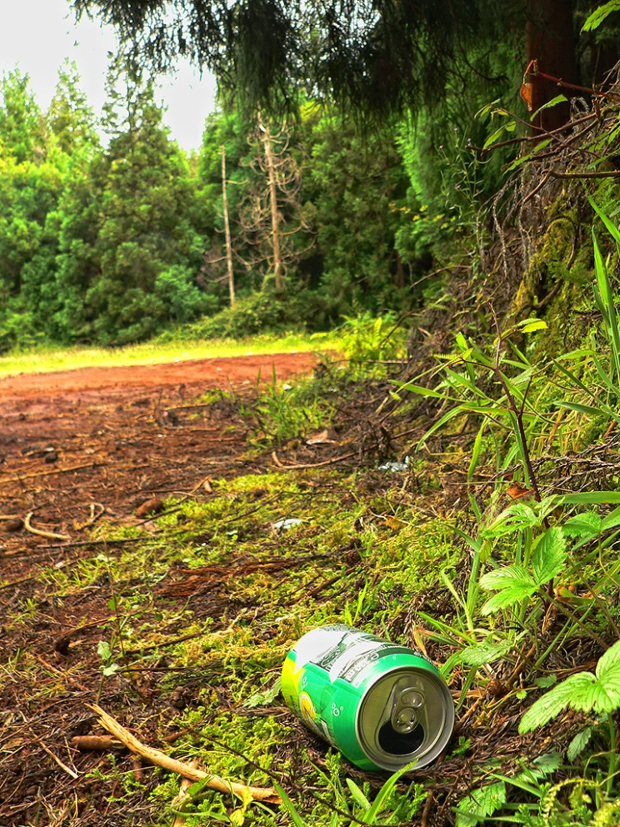
Forests

Slide 24
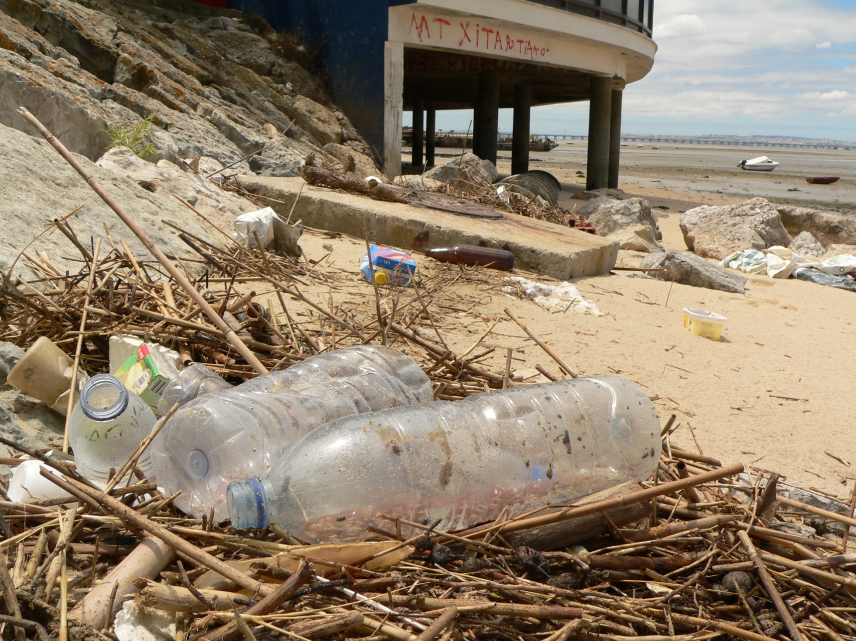
Rivers

Slide 25
How to solve this problem?

Slide 26
If bottles and cans would worth money they would not be thrown away.
Nobody throws money at the floor.

Slide 27
Bottle Bill policy:
It is mandatory that every bottle (even plastic ones) has a deposit bill.

Slide 28
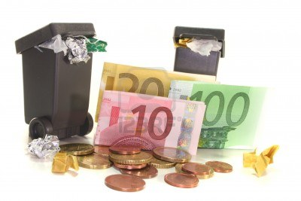
Those who pollute lose money
123rf.com

Slide 29
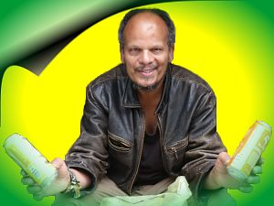
Those who clean are rewarded
Eduard Lüning fought poverty by catching bottles in Germany. feines-buch.com

Slide 30
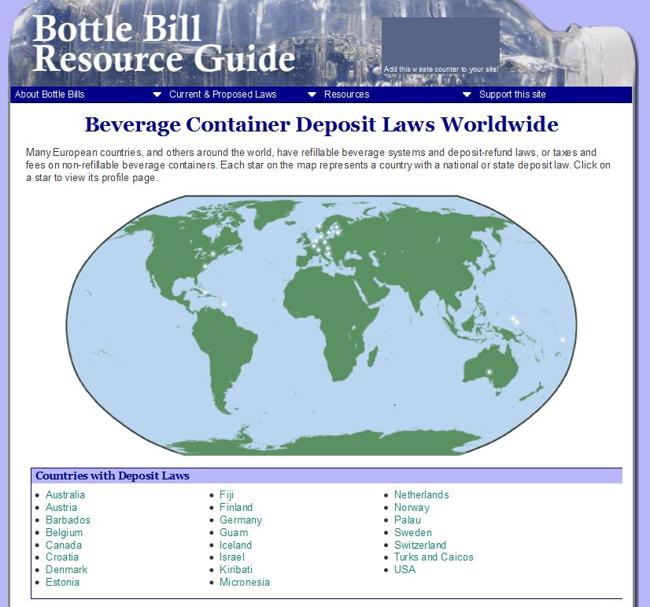
It works in 23 countries
bottlebill.org

Slide 31
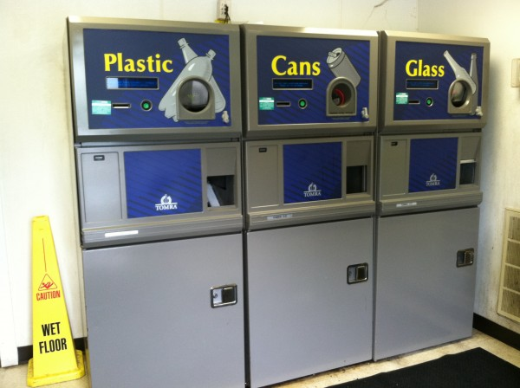
“It pays to recycle”

Slide 32
More advantages of bottle bills

Slide 33
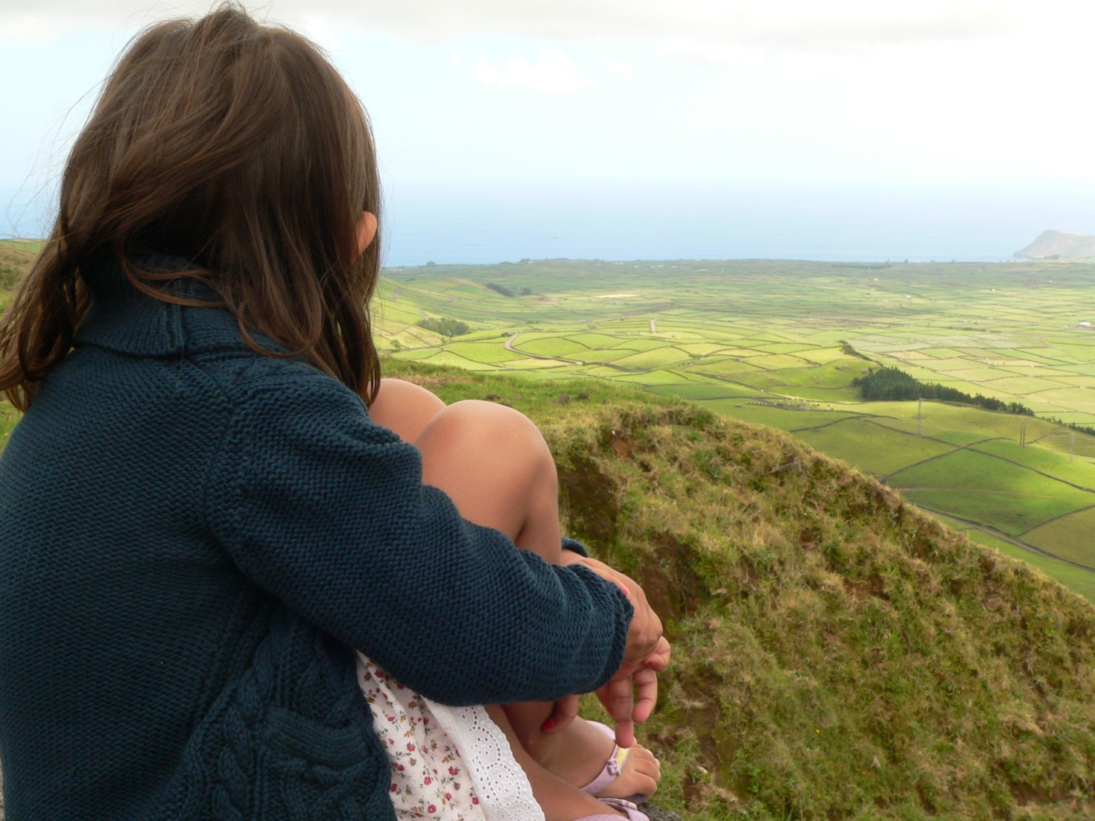
Cleaner environment

Slide 34
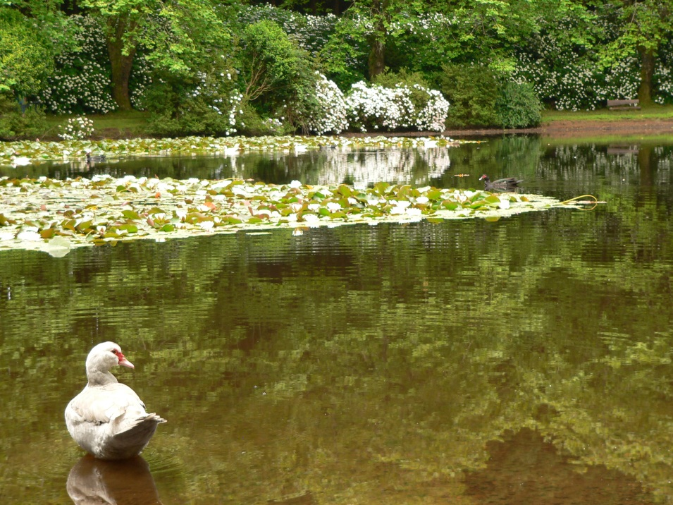
Protects animals from plastic poisoning by ingestion

Slide 35
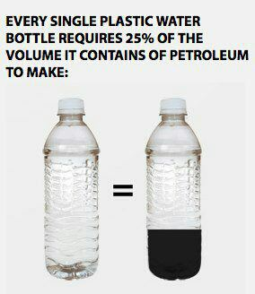
Reduces oil imports
thefreedomfilm.com

Slide 36
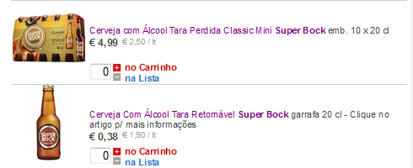
Makes products cheaper to the consumer that recycles
(don’t have to pay for the bottle)
Cerveja em garrafa de tara recuperável é 24% mais barata
continente.pt

Slide 37
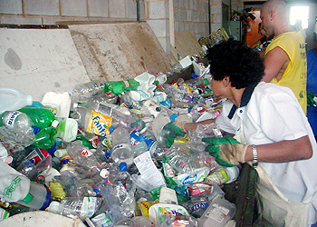
Makes material separation more effective for recycling
tonhoc7.blogspot.pt

Slide 38
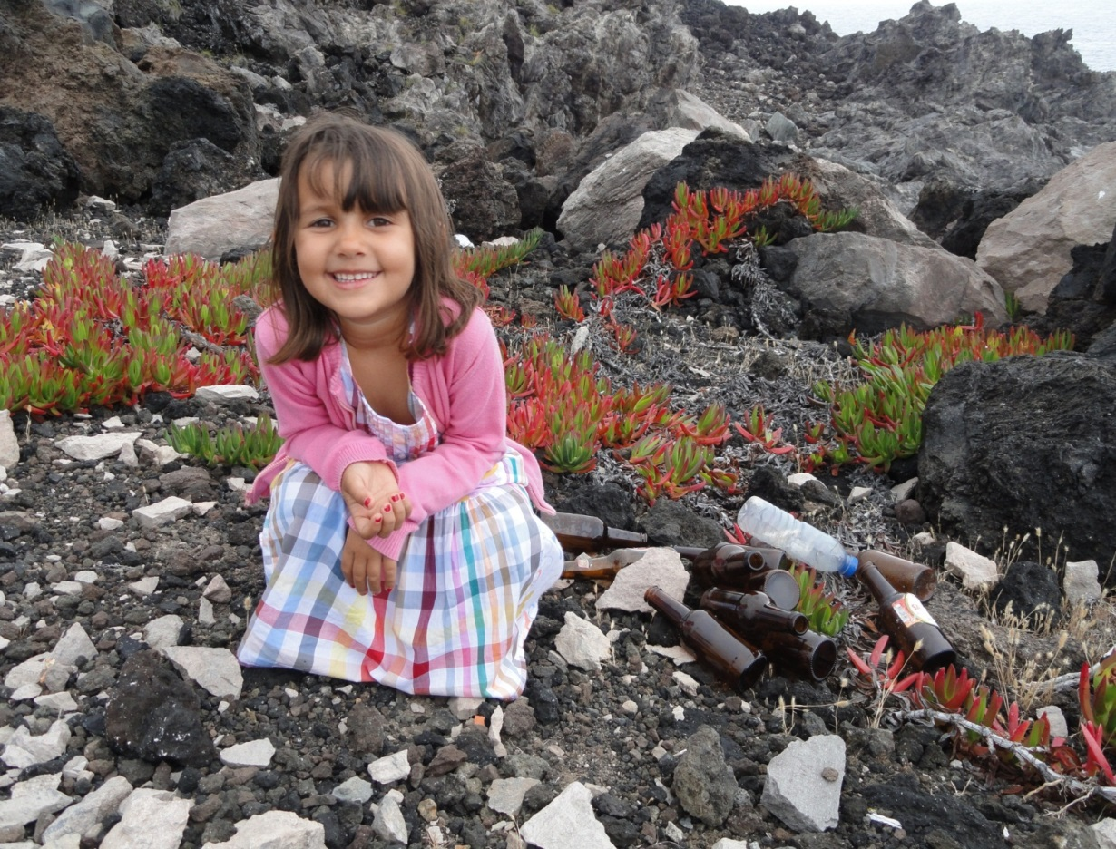

Join us to implement bottle bills in Portugal

Slide 39
Wrap-up
Beach clean-ups to become aware of the Marine Litter problem
Awareness messages reduce cigarette butt pollution
Bottle bills reduce plastic pollution
The previous 2 measures will mitigate the
5 major sources of Marine Litter

